Slide 1
Assignment #6:
Mid-fi Prototype
Team Papaya: Lucy Zhu, Zheng Lian, Xiaohai Liu, Cathy Wang

Slide 2
Introduction

Slide 3
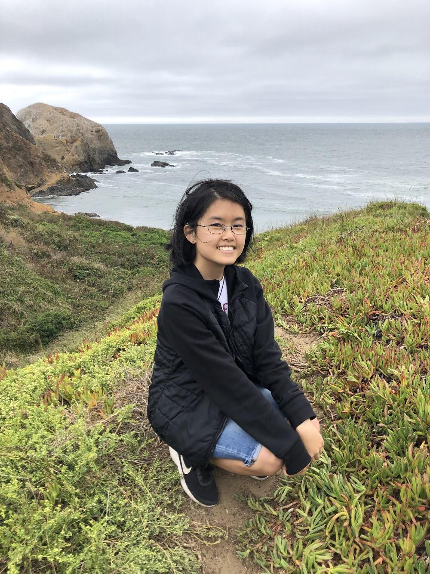
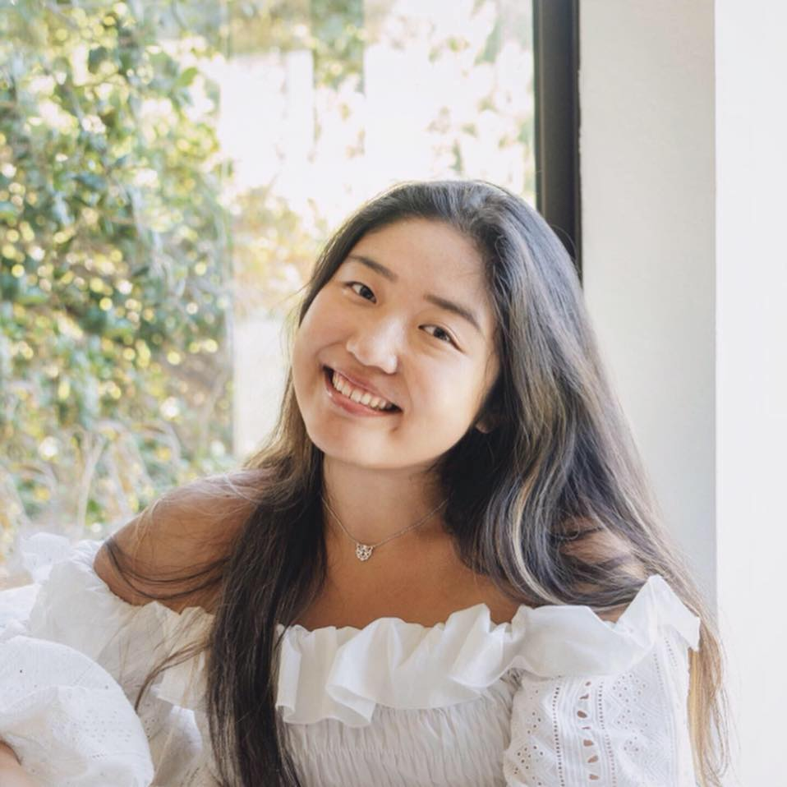
🌟Zheng
🌟Xiaohai
🌟Lucy
🌟Cathy
Team Papaya
Notes:
Our team consists of 4 people: Zheng, Xiaohai, Lucy and Cathy!

Slide 4
RoadMap
Value Prop, Problem and Solution Overview
tasks
Revised interface design
Prototype overview

Slide 5
Value Prop, Problem
and Solution Overview

Slide 6

Visualize
And Share
Your First Design
Visualize
And Share
Your First Design

Slide 7
Problem: Amateur fashion designers often have a hard time getting the recognition they need to kick-start their career.
Solution: We provide a platform for amateur designers to digitize and share their works with a big community of designers, and gain inspiration from others’ work. We hope that this community can bring the support they need to succeed in what they love to do.

Slide 8
2. Tasks

Slide 9
Task 1 (Simple): To create a shareable space demonstrating fashion designs
Task 2 (Medium): To create or modify a fashion design using the provided utilities
Task 3 (Complex): To entirely customize and share a design

Slide 10
3. Revised Interface design

Slide 11
3 a.
Three Major Changes

Slide 12
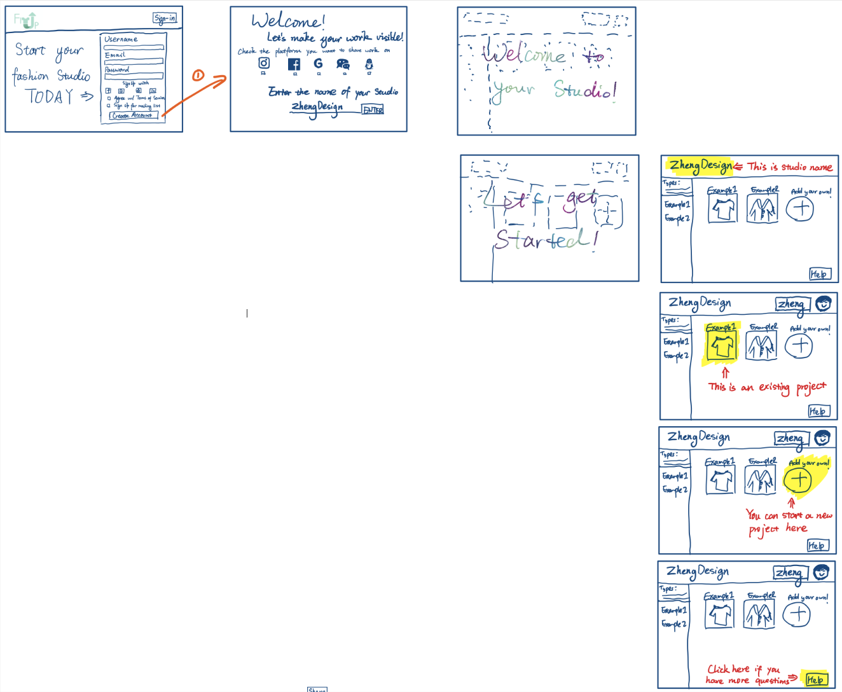
Design Change 1: Added a tutorial to help user navigate their interface after they first created their account
Before After
None :(

Slide 13
Rational:
noticed that users had difficulty understanding some of the functions when they were first exposed to the product
allows a greater degree of complexity in functions without sacrificing its intuitivity
Notes:
Unless folks decide to skip the tutorial.

Slide 14
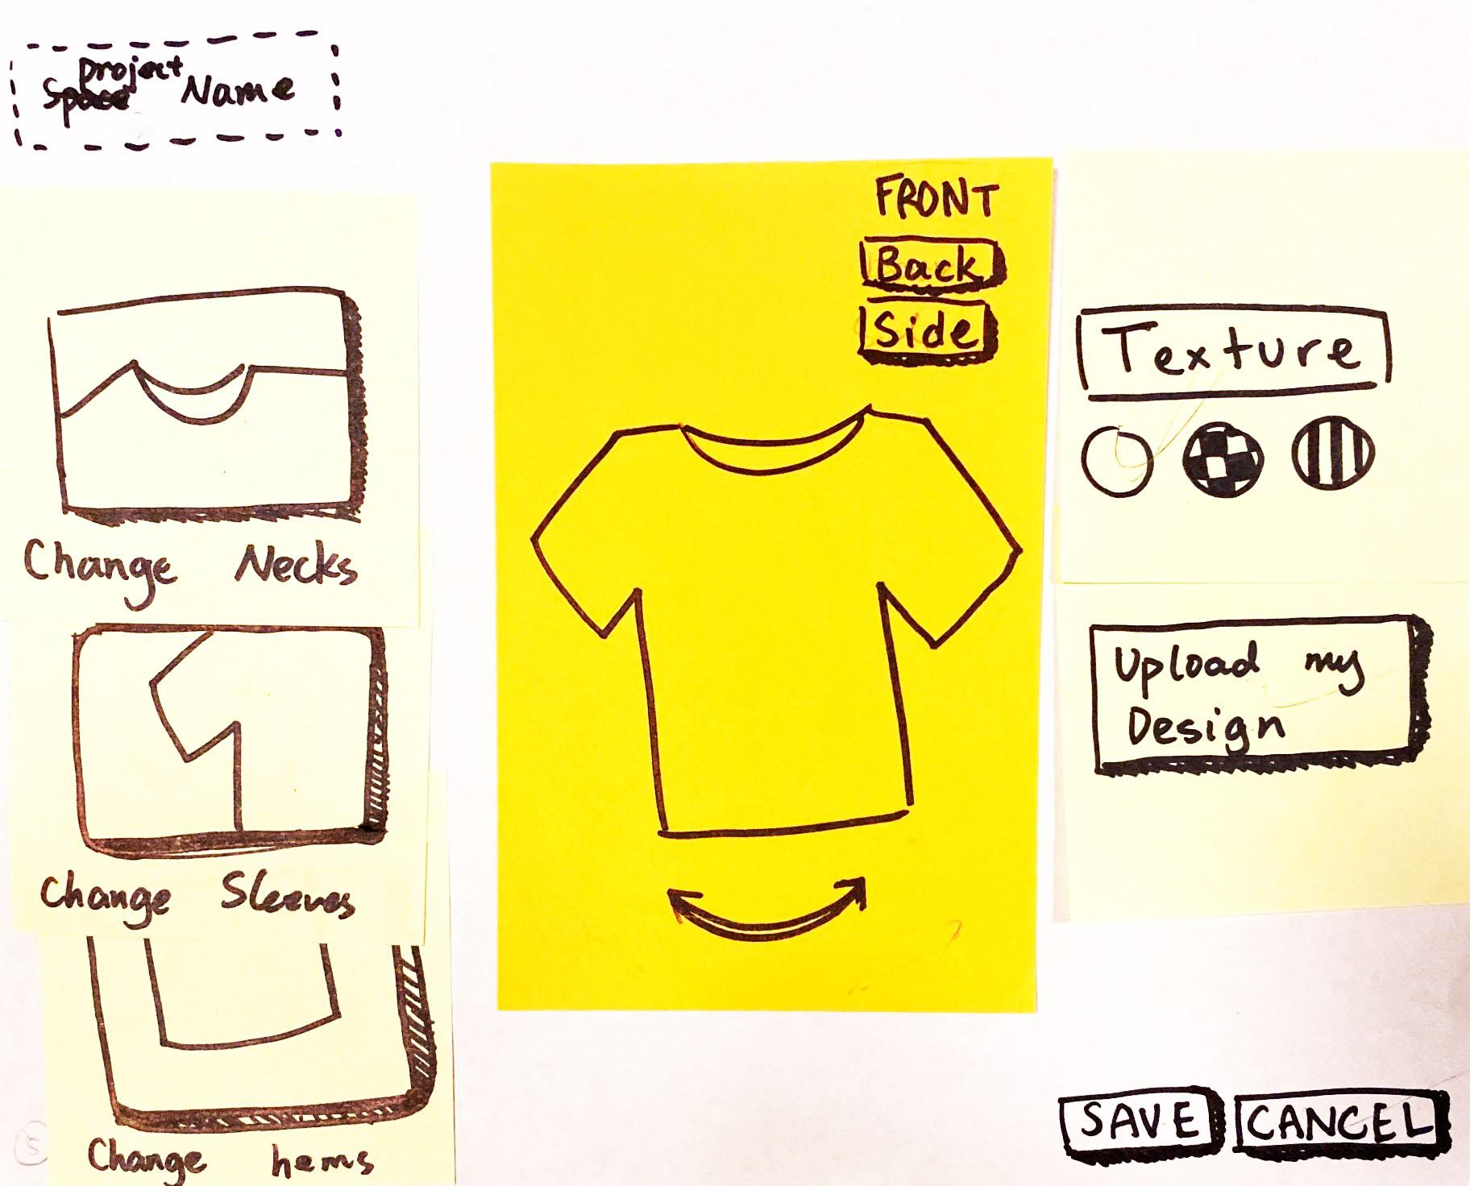
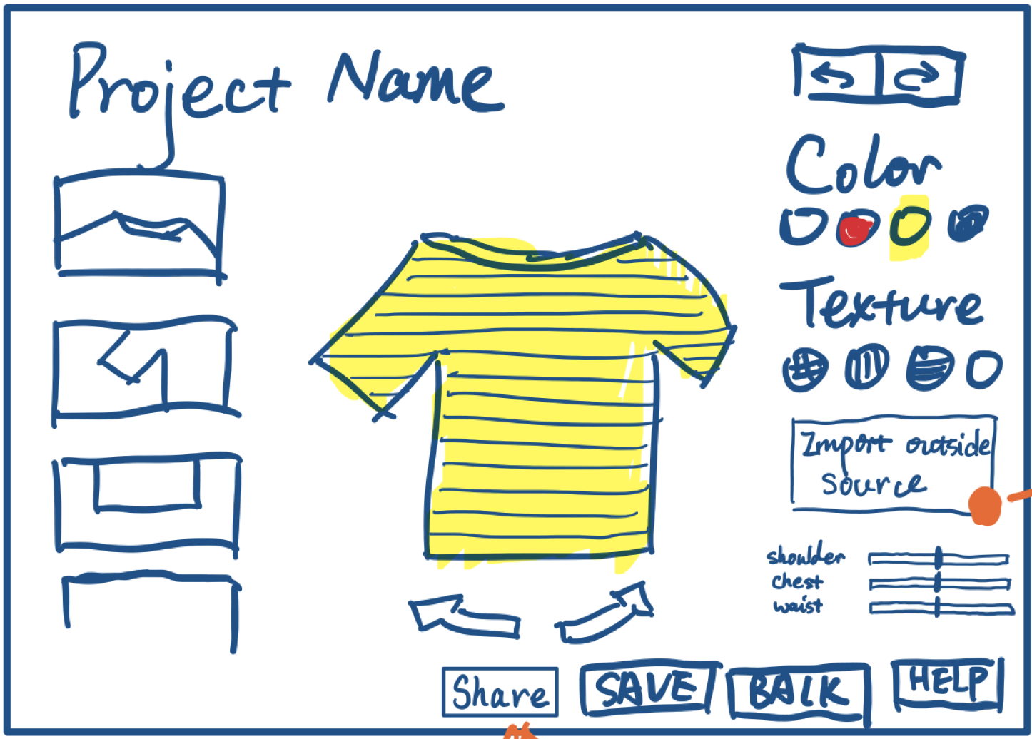
Design Change 2: More customizable options and intuitive buttons
Before After

Slide 15
Rational:
prototype users frequently commented on how it felt like a game
Introduce more versatility in program’s capabilities

Slide 16
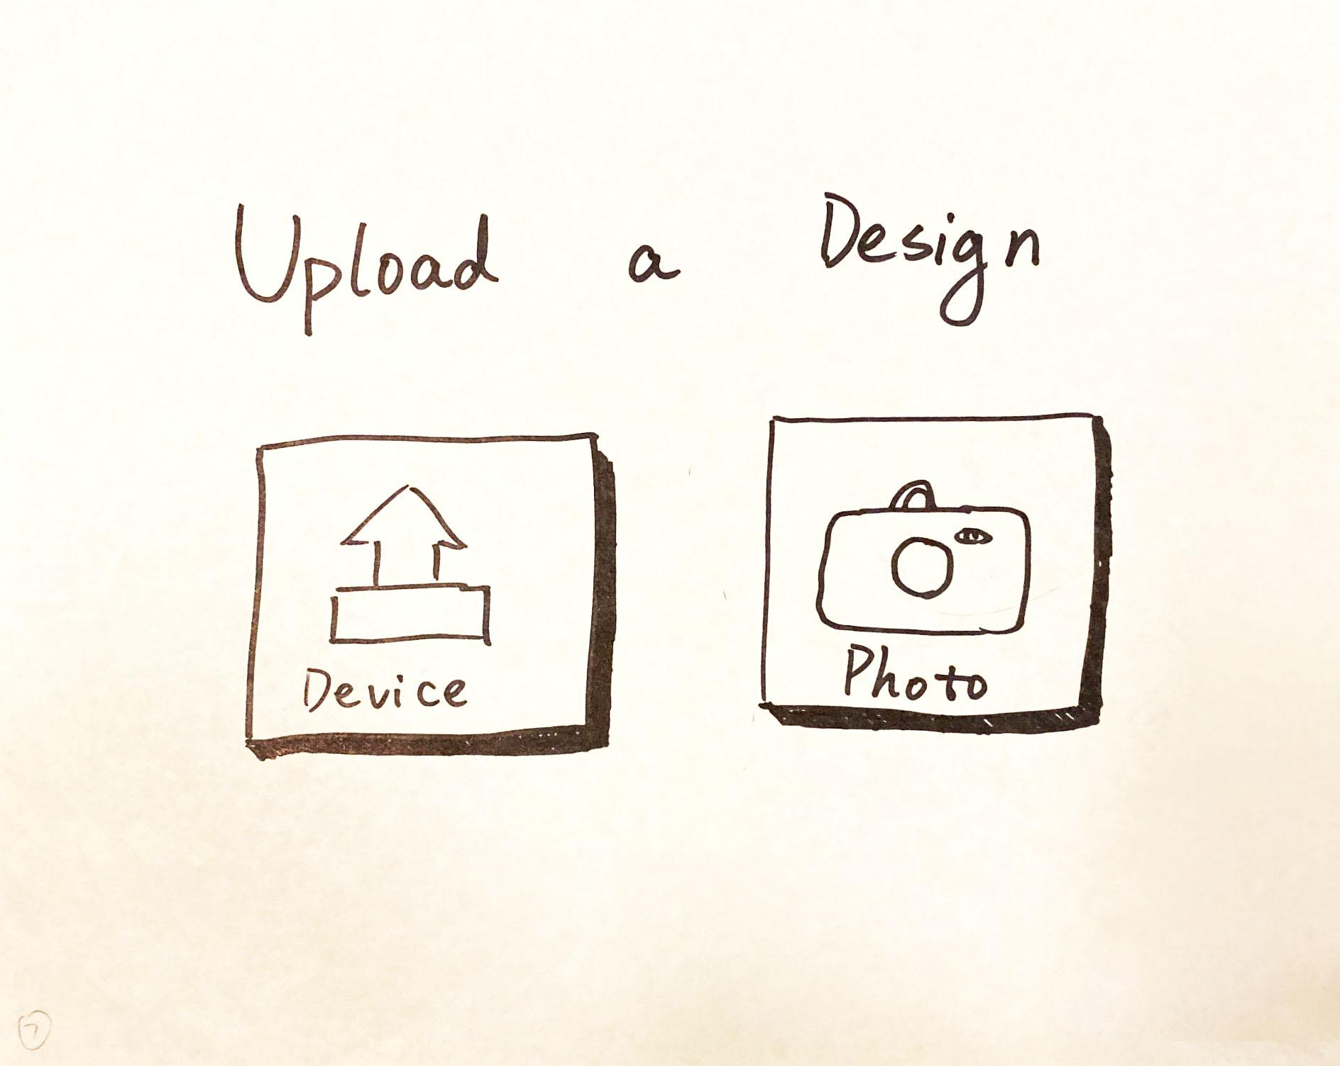
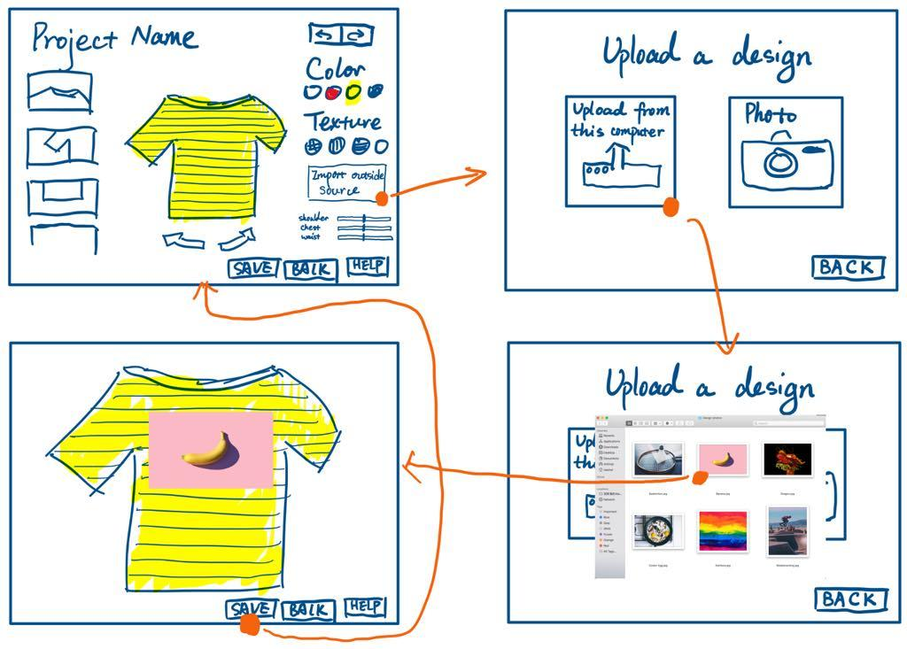
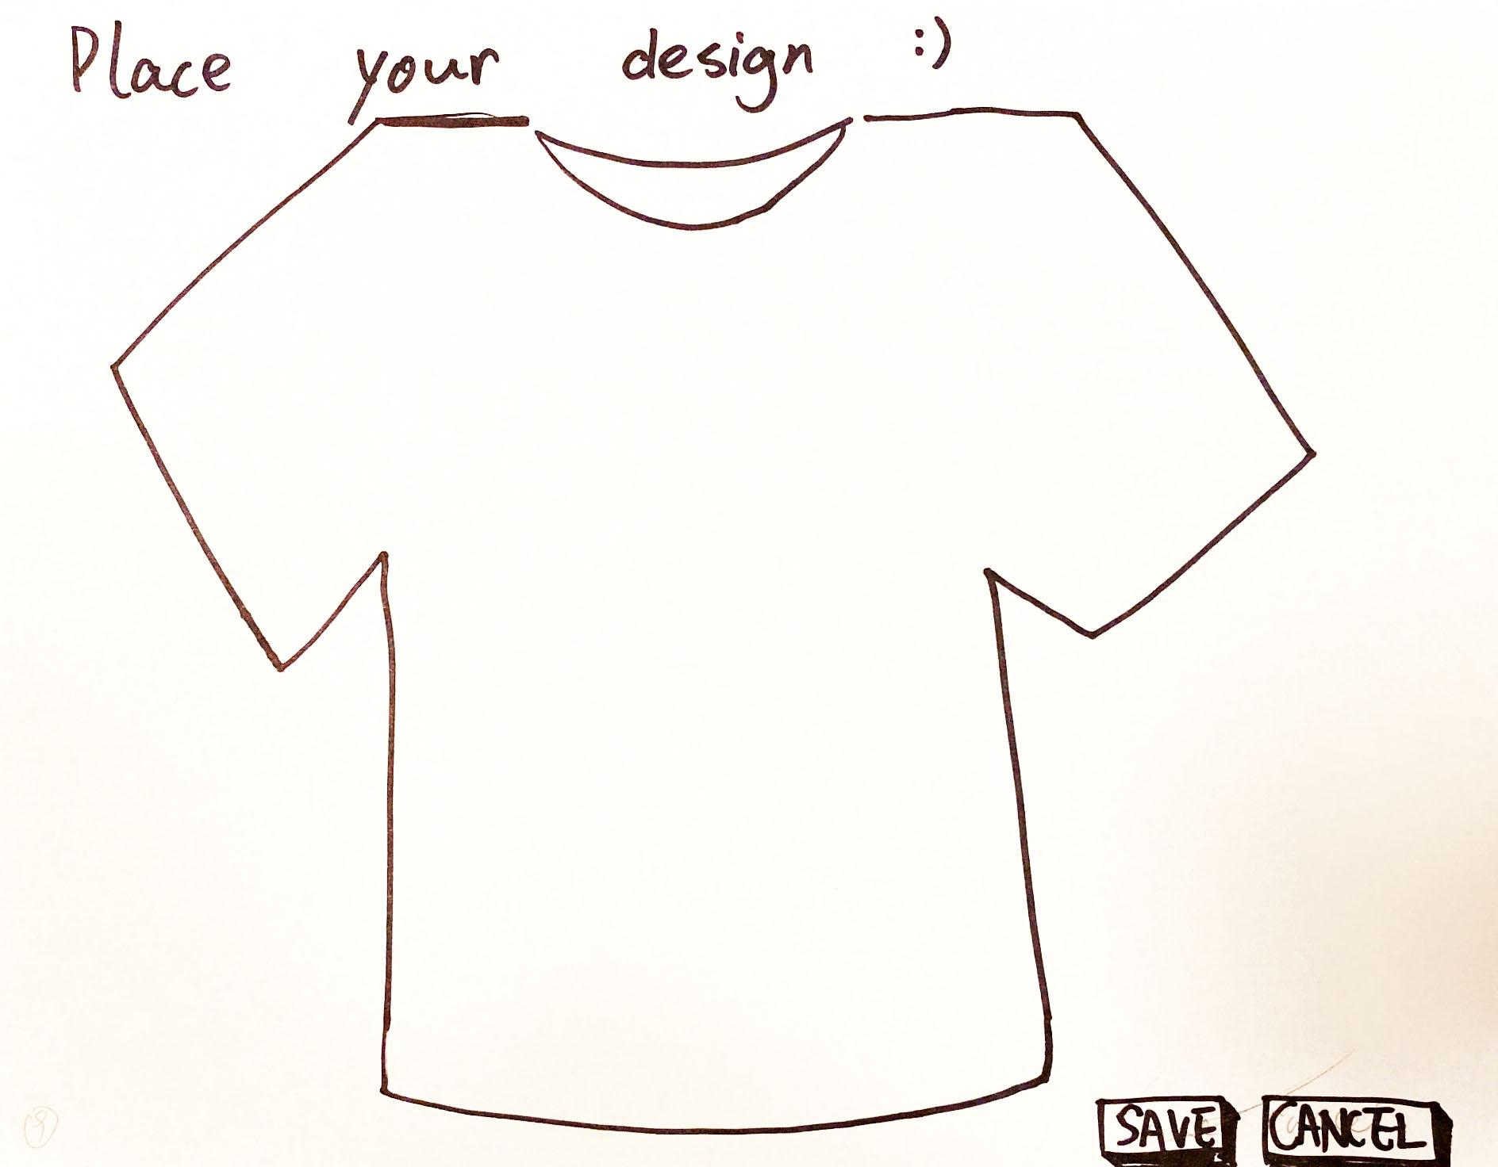
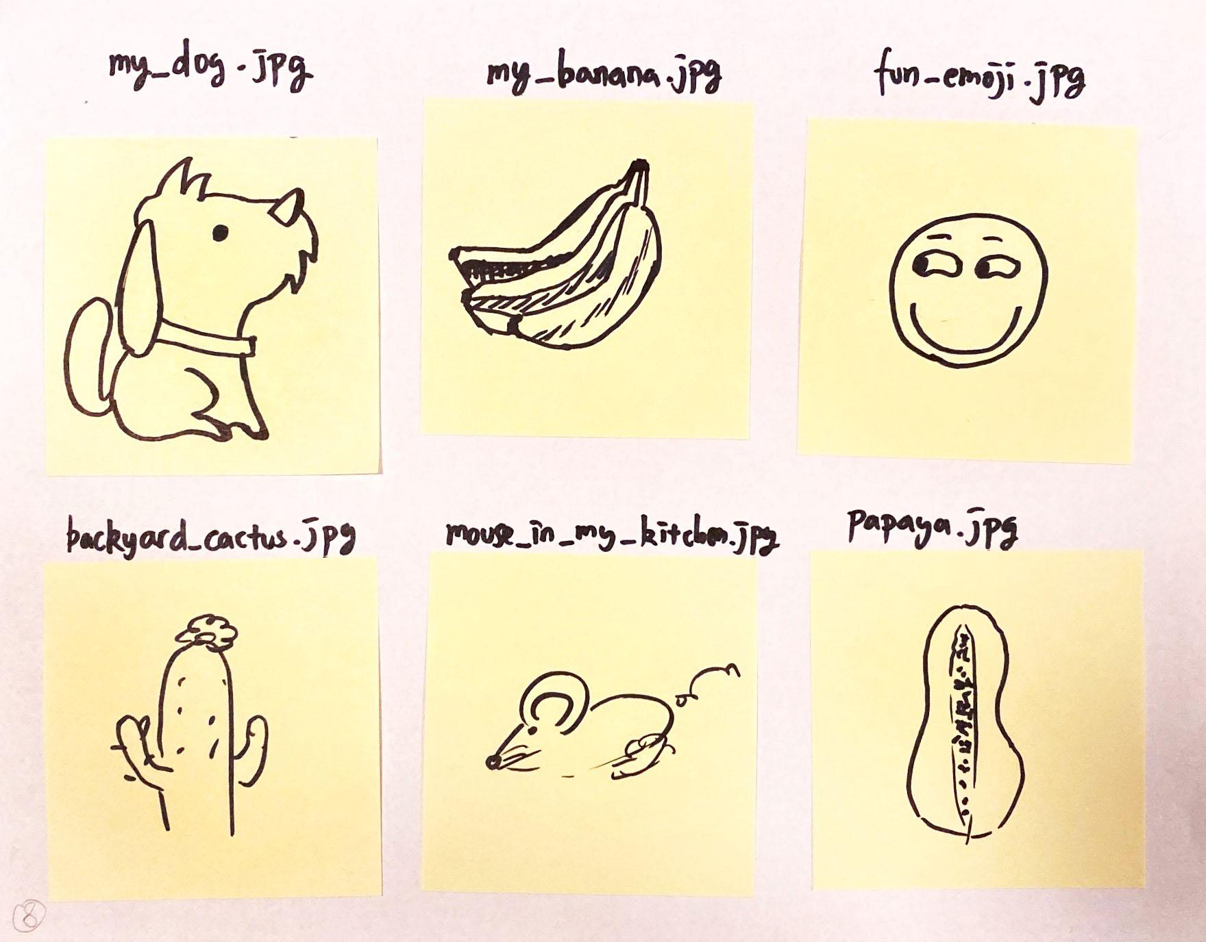
Design Change 3: “Upload my design” => “Import outside source
Before After

Slide 17
Rational:
Wording plays a major role in user’s understanding of website functions
Ambiguous labeling => confusion
(also mitigated via adding a tutorial)

Slide 18
3. B
Task flows

Slide 19
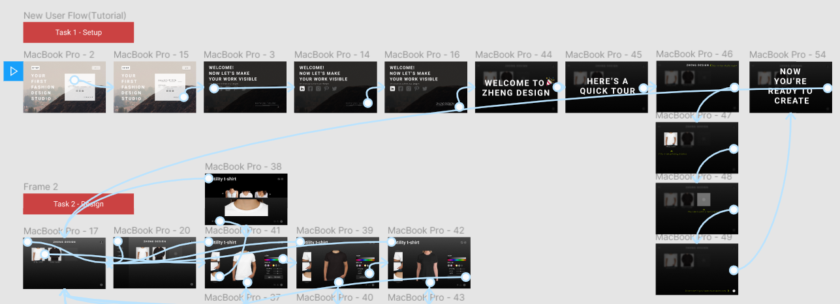
Task 1 Flow

Slide 20
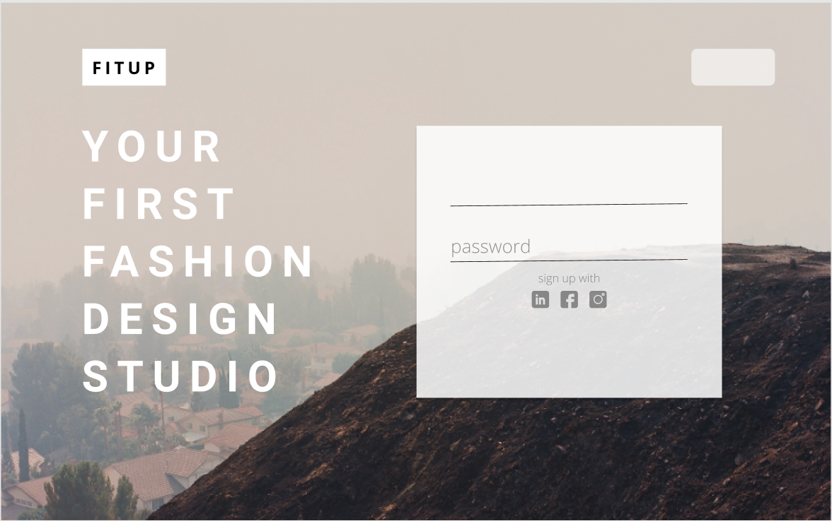
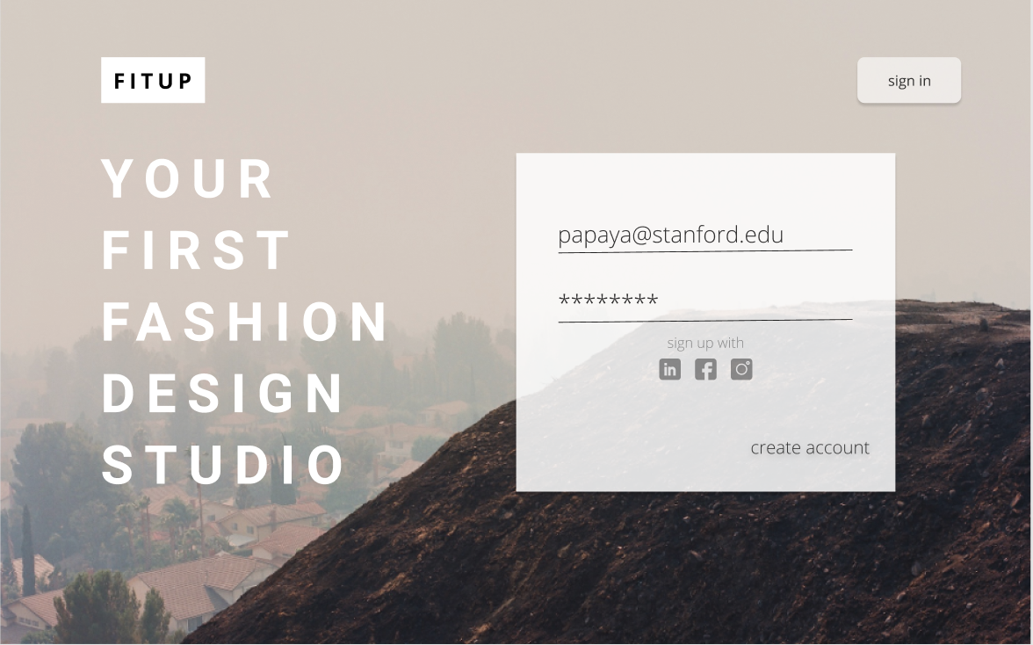
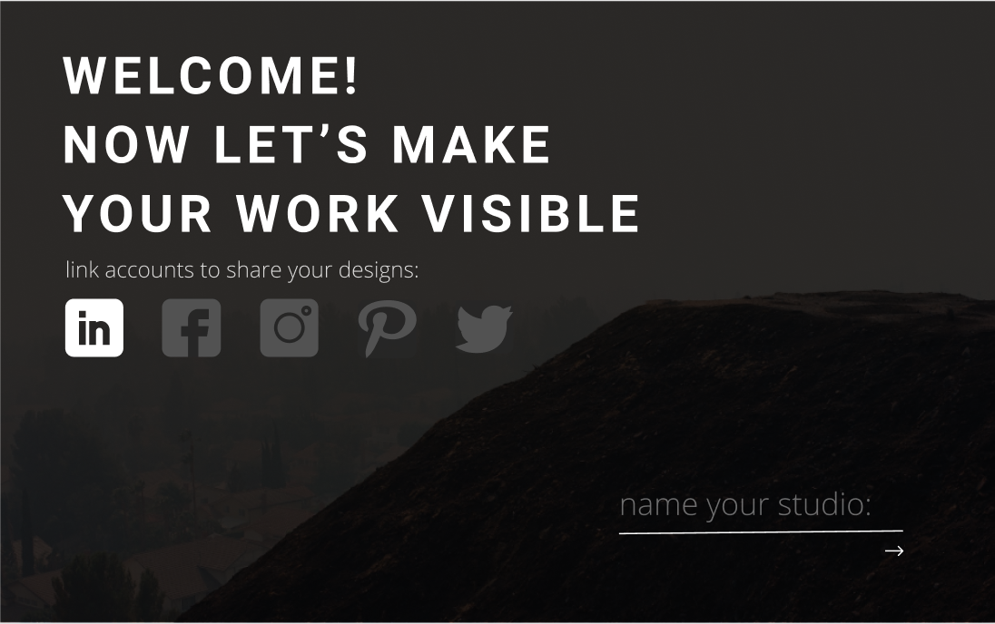
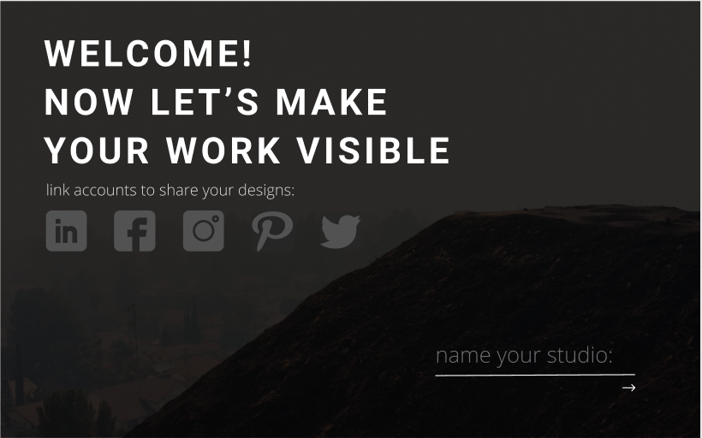

Slide 21
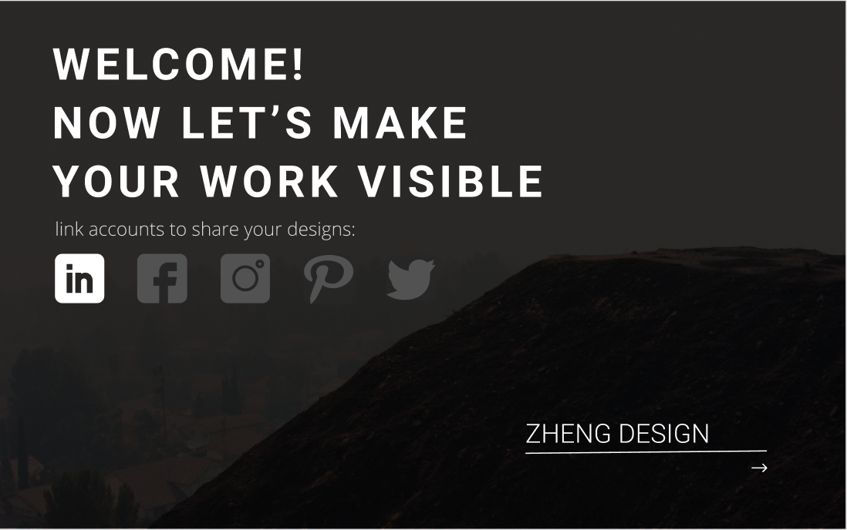

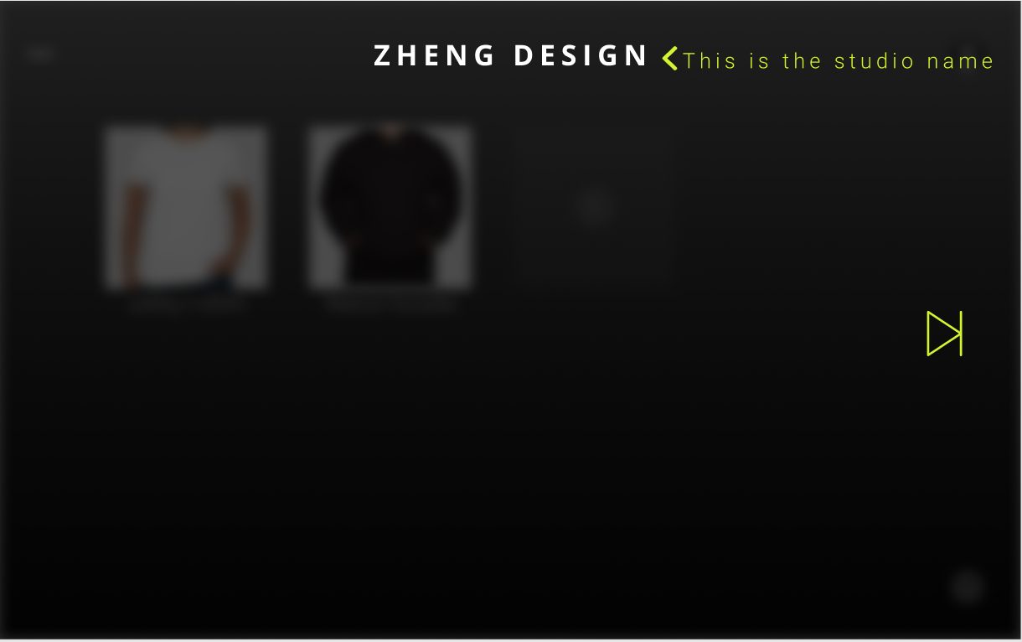
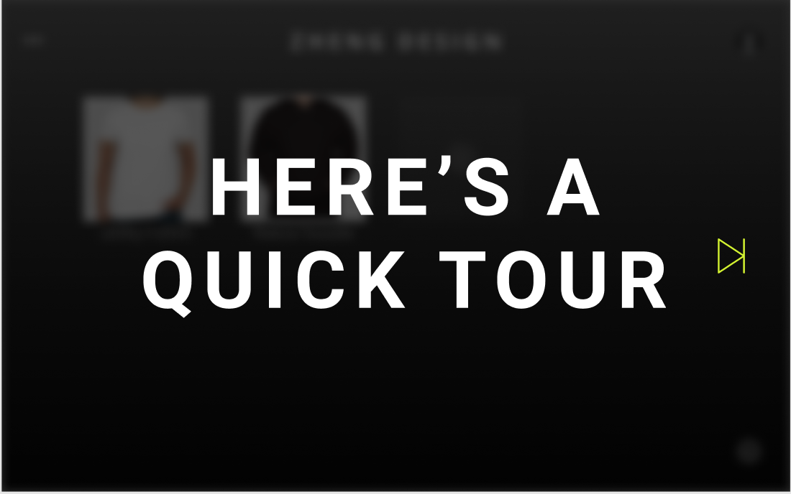

Slide 22
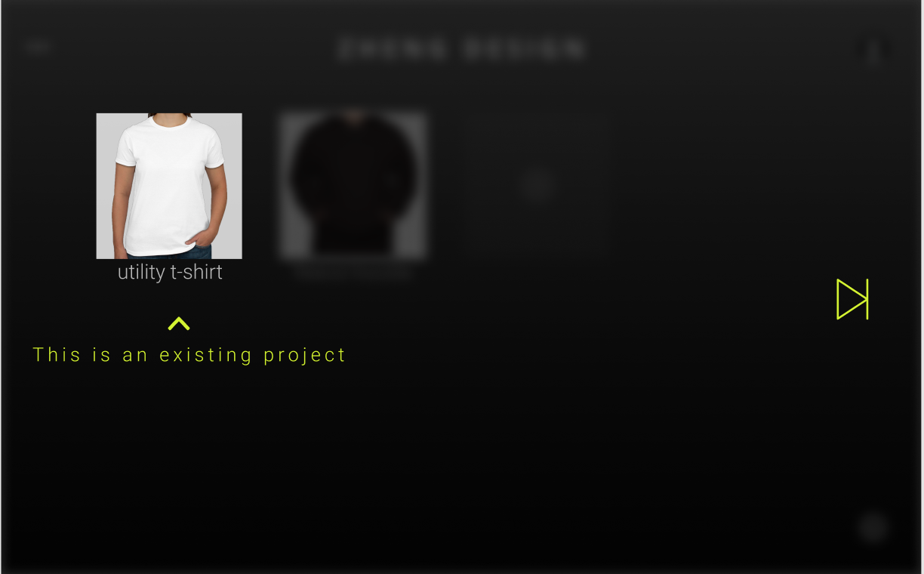
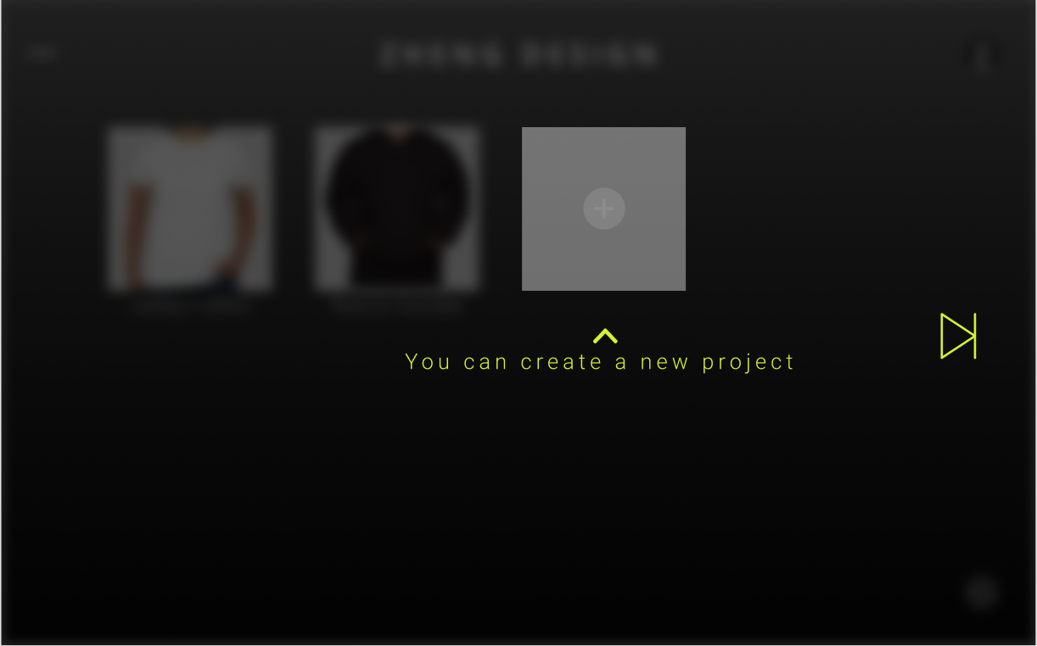
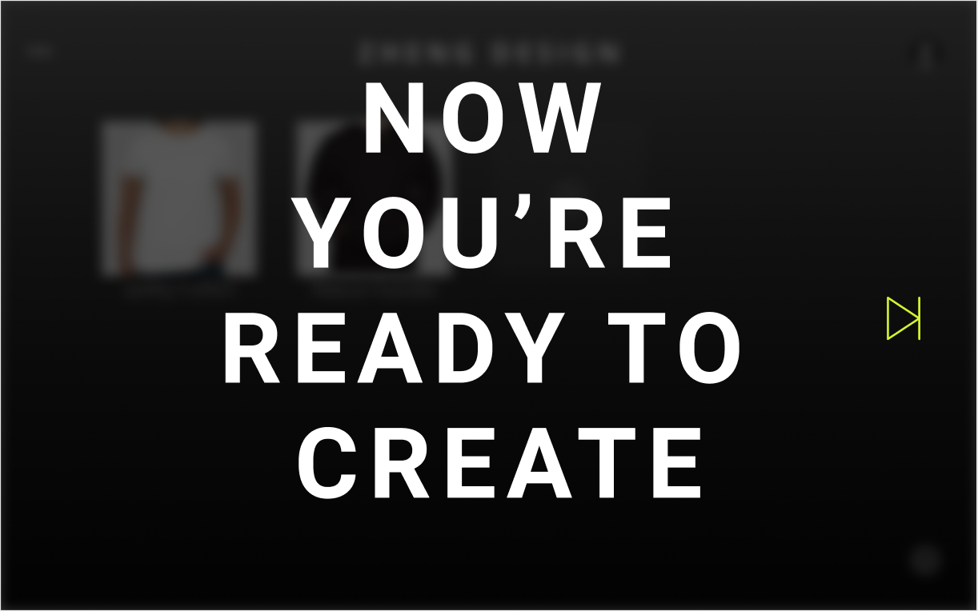
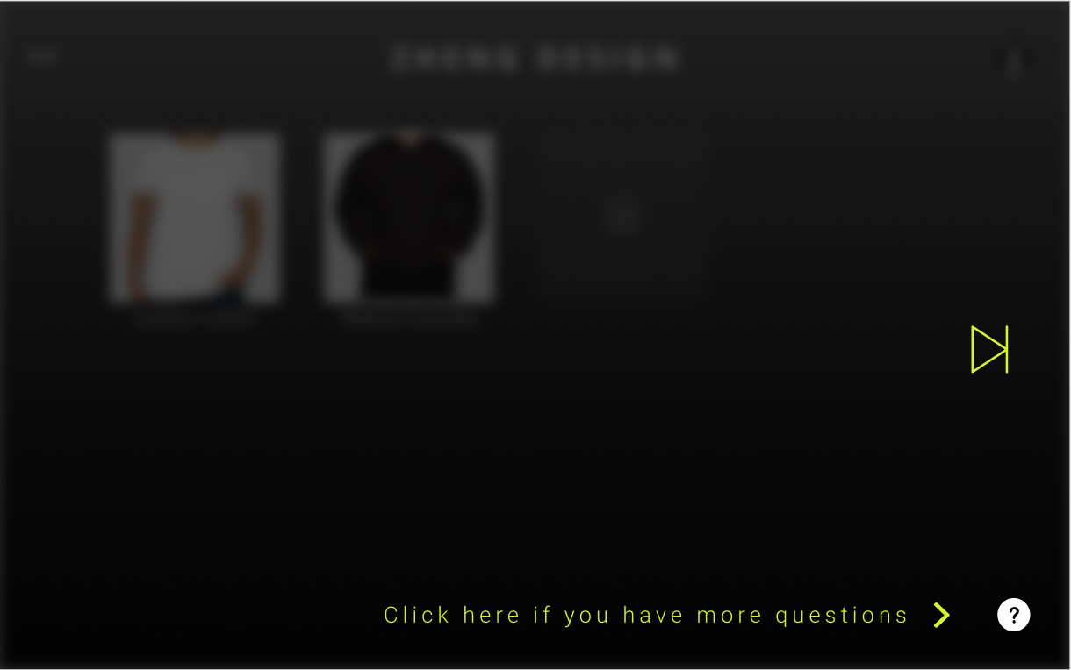

Slide 23
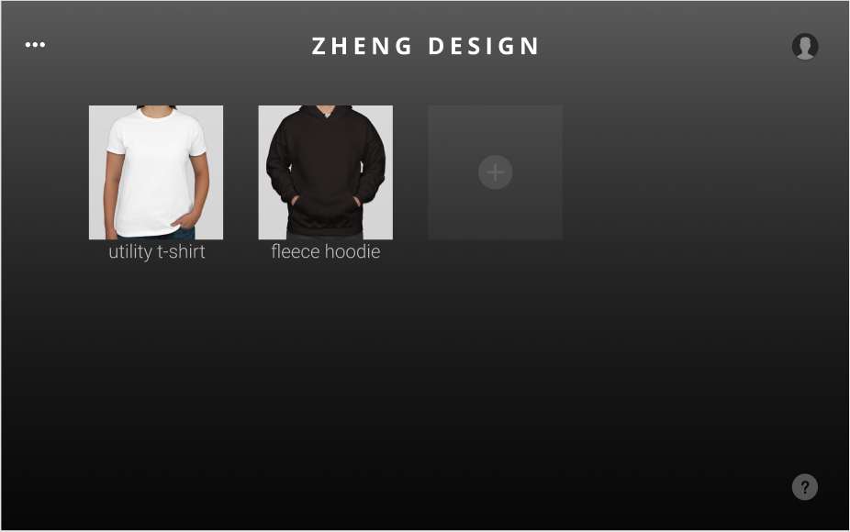
Final landing page after setting up the user’s studio

Slide 24
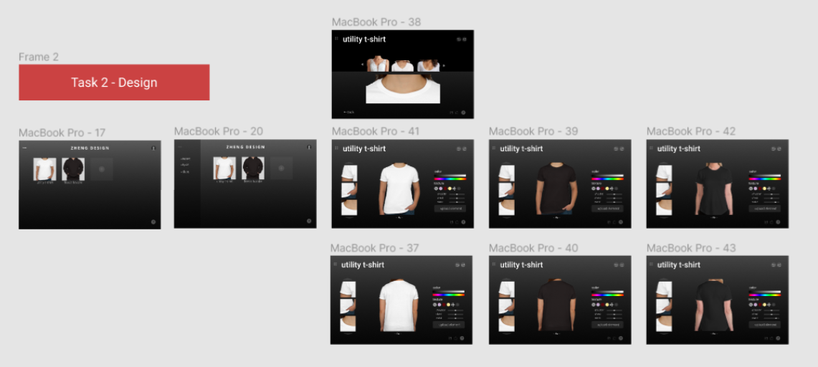
Task 2 Flow

Slide 25
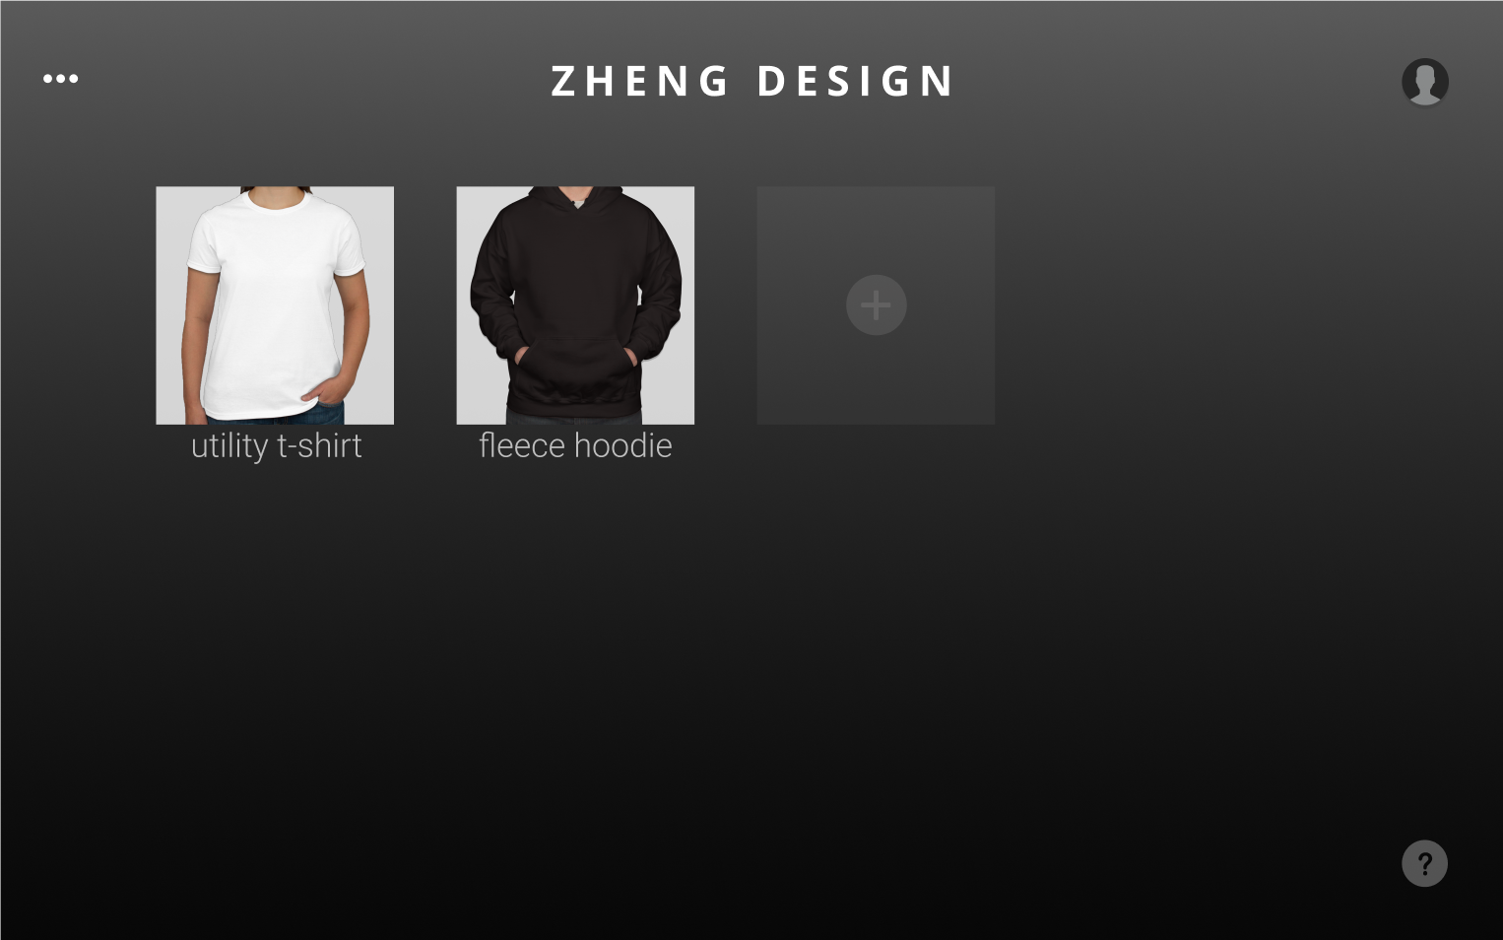
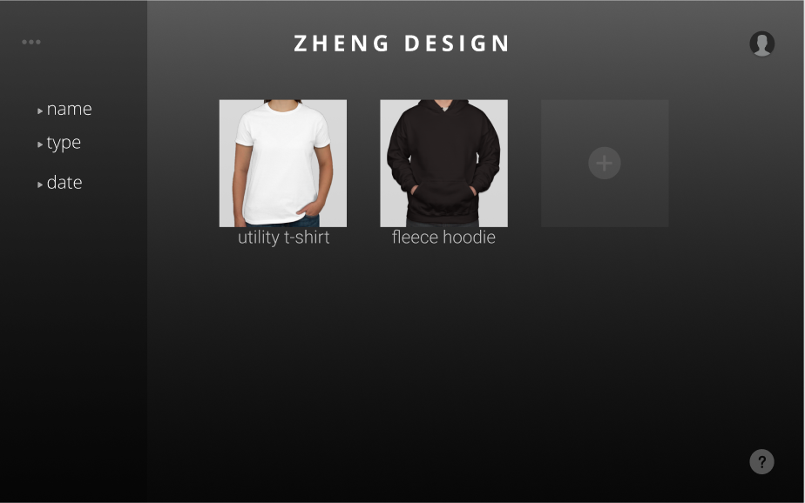
Display project sorting options

Slide 26
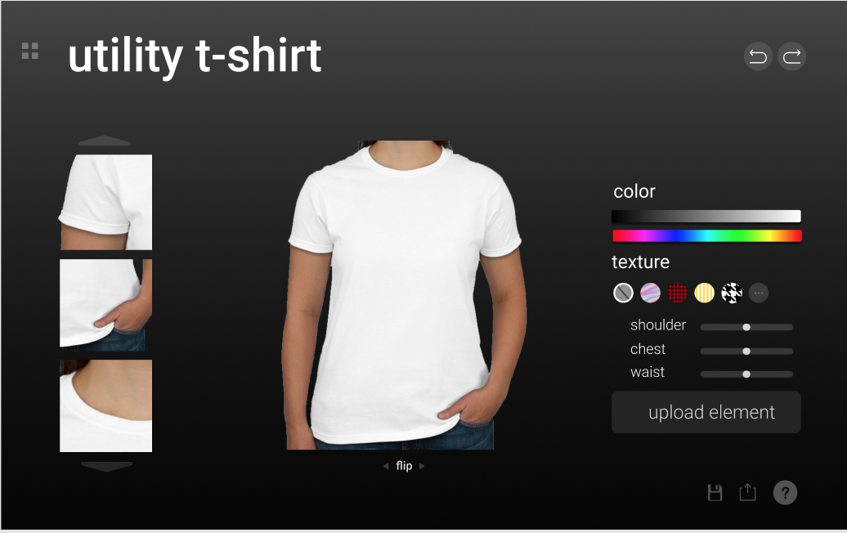
Open up an existing project

Slide 27
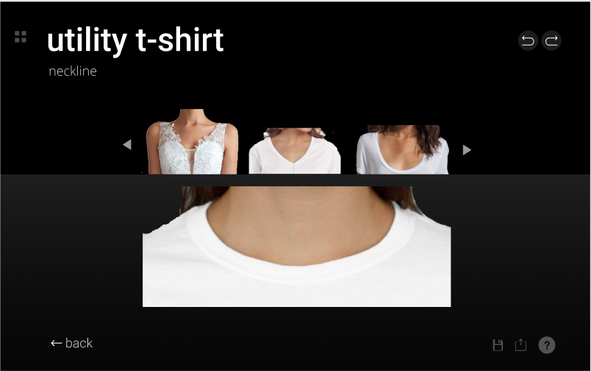
Go into neck editing

Slide 28
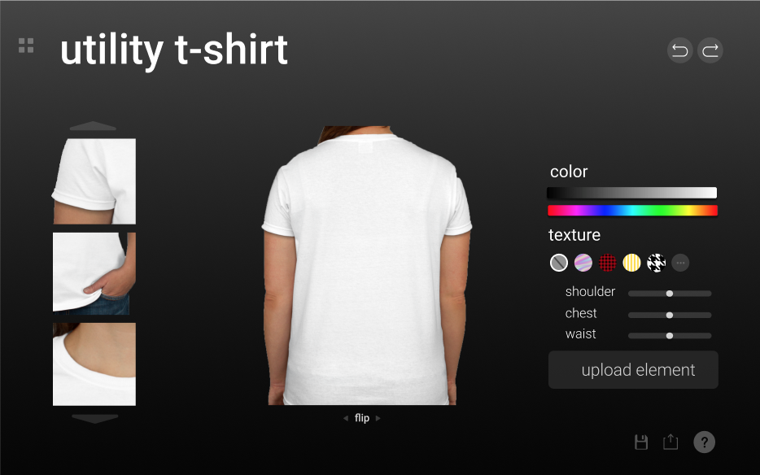
Flip a design

Slide 29
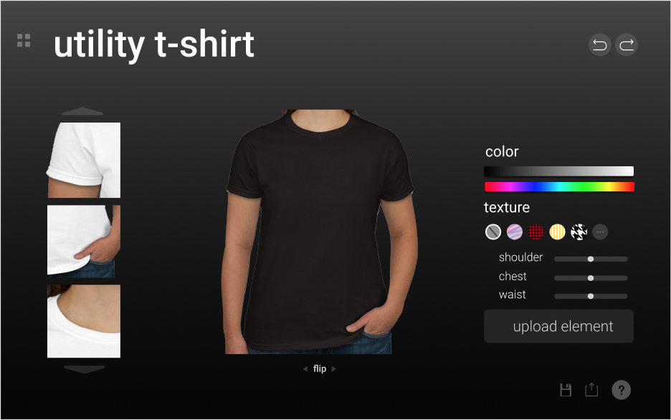
Change the color

Slide 30
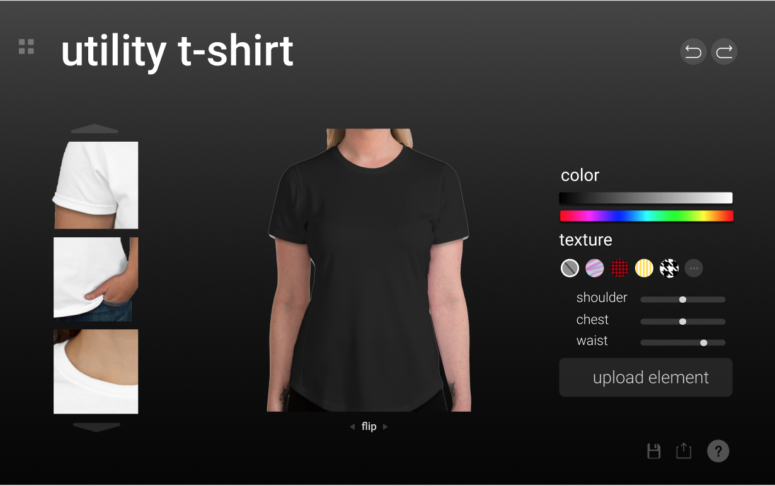
Change waist length

Slide 31
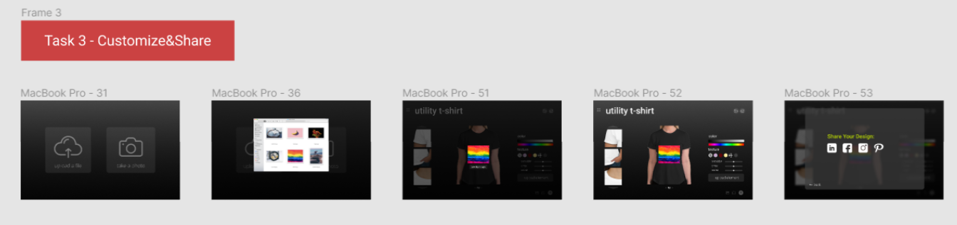
Task 3 Flow

Slide 32
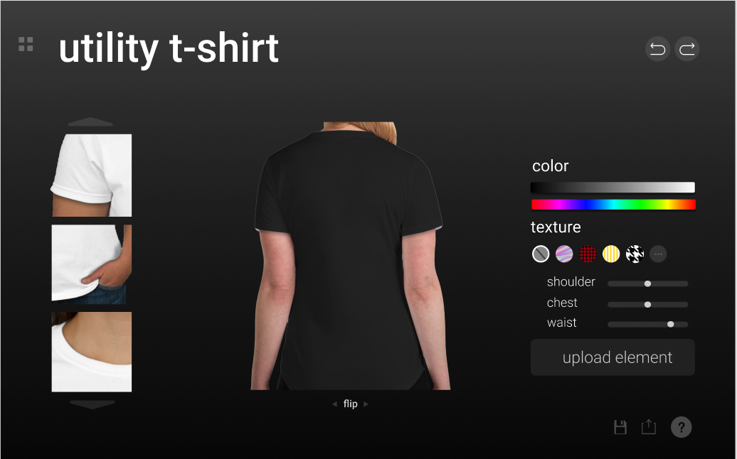
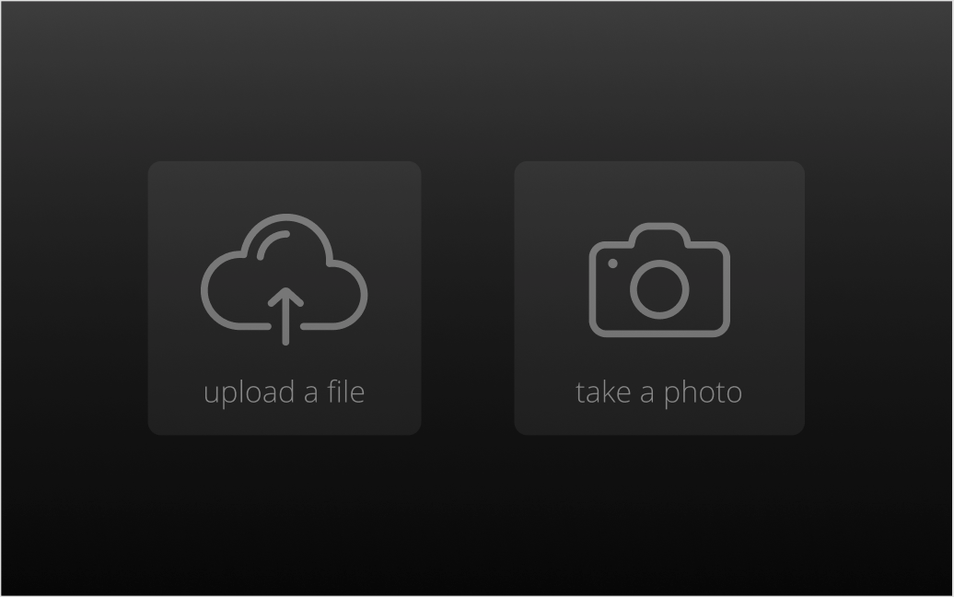
Upload user’s own element

Slide 33
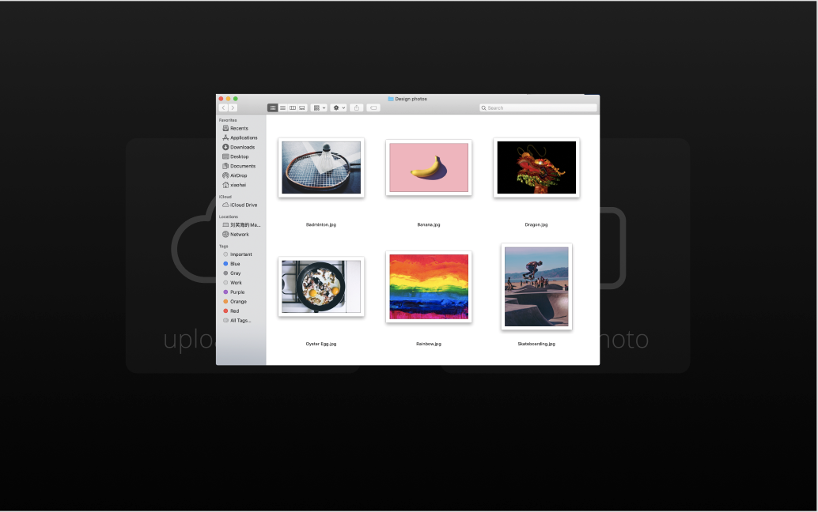
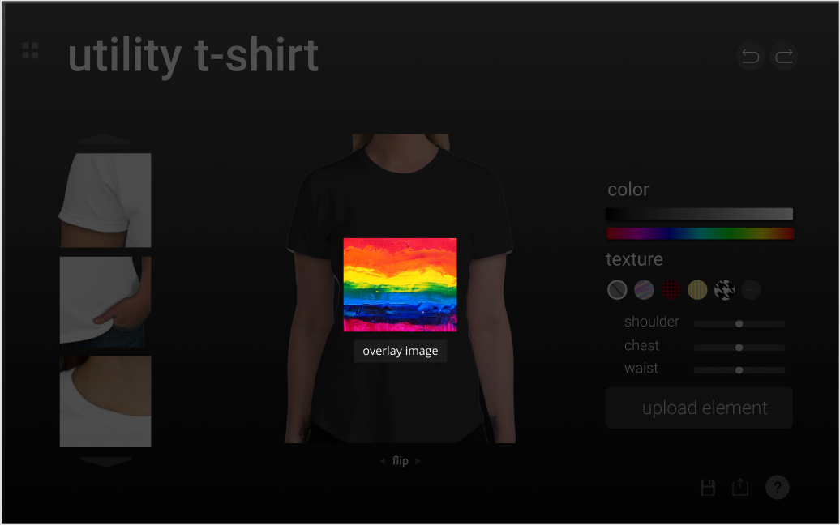
Upload user’s own element

Slide 34
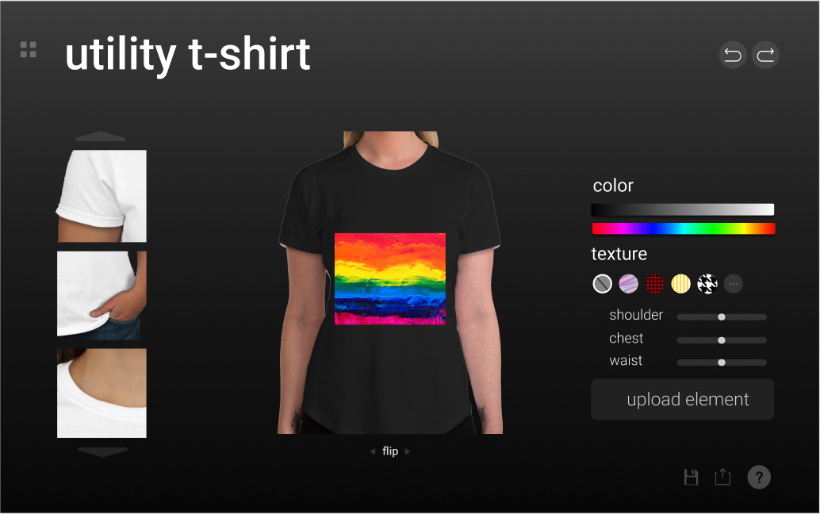
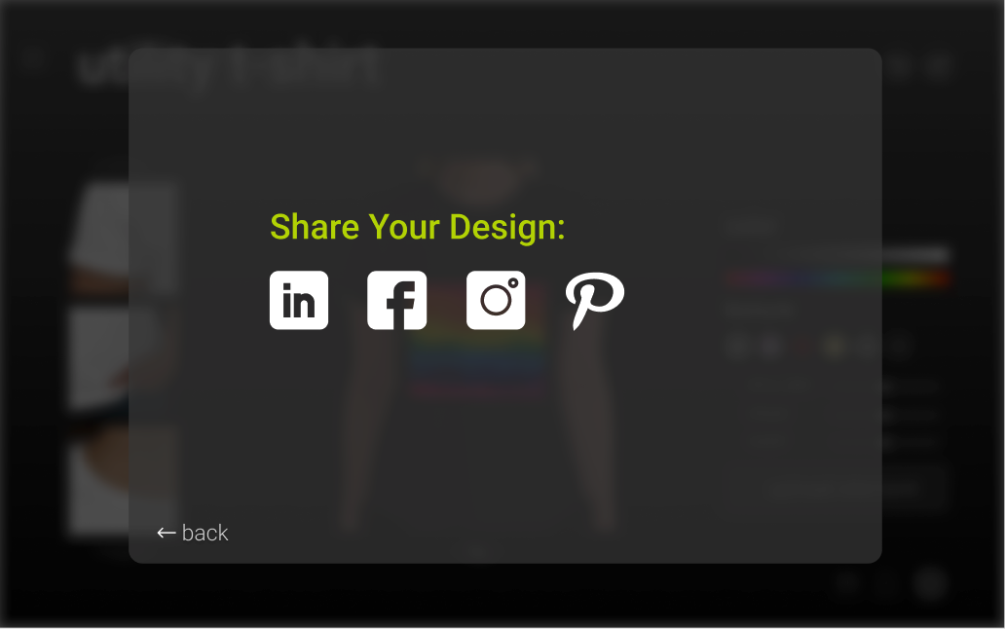
Share the design to other channels

Slide 35
4. Prototype overview

Slide 36


Design Tools: Figma & Photoshop
PROS
CONS
flexible
able to produce clean interface design
resulting design close to desired design
steep learning curve for the more complex features
limited interactivity able to be implemented; we had to resort to click-based

Slide 37
limitations/Trade offs of the current prototype
Limited task flow
Design choices restricted to demonstrate all tasks
Changes made in one place might not show up in another place. For instance, the preview of a project in the home page does not synchronize after the user changes the shirt to black in edit mode

Slide 38
Wizard of Oz Techniques
Textual inputs like email and name
Pressing of buttons in designing one’s own clothing
Selection of platforms to share one’s own fashion design

Slide 39
Hard-coded features and why required:
The photos the user sees when they click “Upload Device” because we can’t actually connect to user’s computer through our prototype
Which option the user can choice out of a group (like colors or waist length) due to time constraint
Text input due to choice of design tool not supporting it

Slide 40
THANKS!
Any questions?

